Slide 1
Adventure RPG Game
By:
Mark Klick and Ian Jones

Slide 2
Problem Definition
We created an RPG game
Used inheritance
Used dynamic memory with pointers
Used vectors
Main Character
has an inventory and the ability to use it
ability to attack
a way to increase stats
Multiple rooms of play
rooms produce enemies
enemies in these rooms drop loot

Slide 3
Itemized Requirements
and Challenges
Requirements:
Inheritance of classes
polymorphism
declaring item pointers and creating new subclass item objects
vectors of pointers to item and enemy objects

Slide 4
Itemized Requirements
and Challenges
Challenges:
Getting player to interact with enemy objects
room class made this possible
Developing methods for this combat room
I.E. lootroom(), combat(), addenemy()

Slide 5
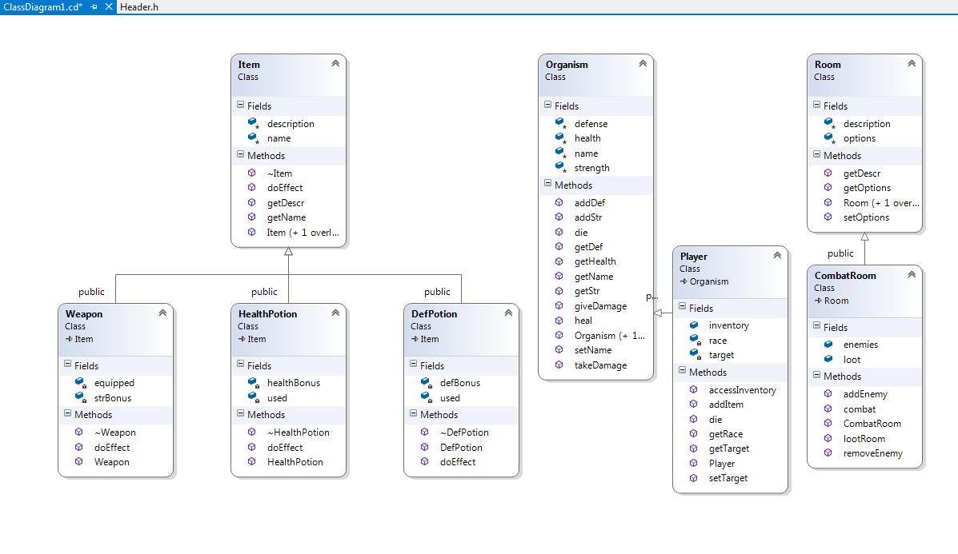
UML Diagram

Slide 6
Code Example:
lootroom()
void CombatRoom::lootRoom(Player* player)
{
cout<< " You have discovered new items after vanquishing the monster."<<endl;
for(int i = 0; i < loot.size(); i++)
{
cout<<
"\n\t"<< i + 1 <<" - "<< loot[i]->getName() << "\t" << loot[i]->getDescr();
player->addItem(loot[i]);
}
}

Slide 7
Code Example:
addEnemy()
A simple vector method use
void
CombatRoom::addEnemy(Organism* enemy)
{
enemies.push_back(enemy);
}

Slide 8
General Approach
Started with base classes
I.E. item, organism, and room
Defined fields for each class and general methods
Developed subclasses for each base class
Developed user defined functions for player
I.E. attack(), preproom(), endgame()
Developed combat methods
core of game play
allowsfor player to interact with item and enemy vectors

Slide 9
Cool factor
Dynamically created player object
game play
combat room class
main driver

